Slide 1
Welcome to Year 4
Miss Ryan
Mrs Slocombe
Mrs Kirby (Thurs)

Slide 2
Our Values
Love - we will show love by putting others before ourselves.
Courage – we will commit to what is right and true, persevere when we are challenged and we will not be discouraged.
Fellowship - we will work together to achieve shared goals. Overcoming and celebrating our differences.
Notes:
Our school values have been updated to reflect the changing nature of our school. These values will woven throughout our curriculum, worship and daily life in school.

Slide 3
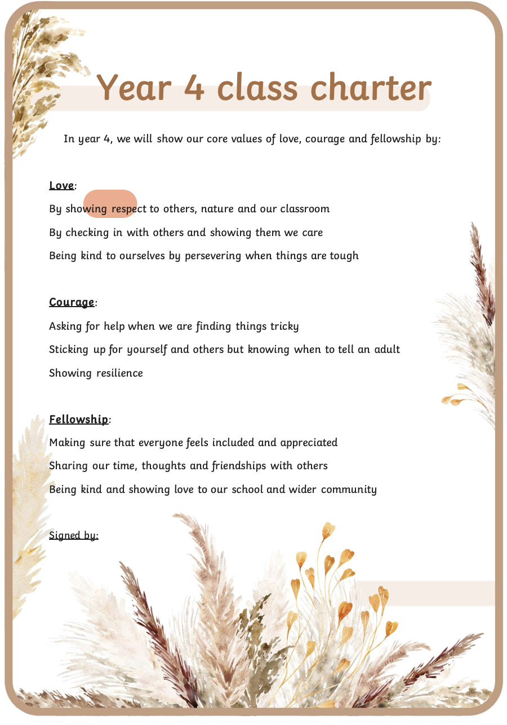
Class Philosophy

Slide 4
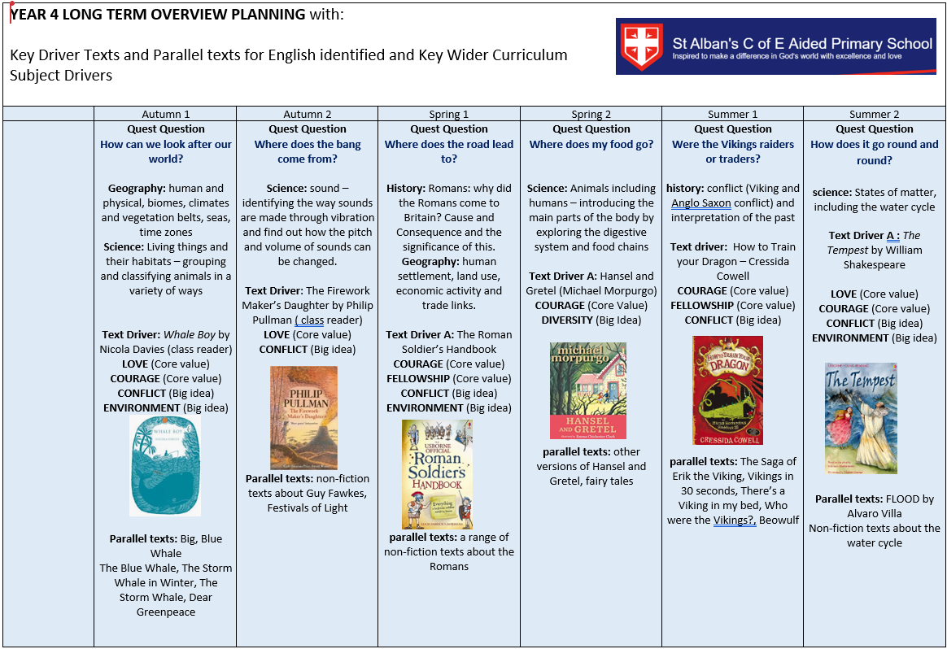
Learning Quests
Notes:
This is an overview of our learning quest for this half term. All out learning is now linked into themes. This is an overview of what we are learning. These have been sent home and can be found on the school website.

Slide 5

Learning Quests
Notes:
This is an overview of our learning quest for this half term. All out learning is now linked into themes. This is an overview of what we are learning. These have been sent home and can be found on the school website.

Slide 6
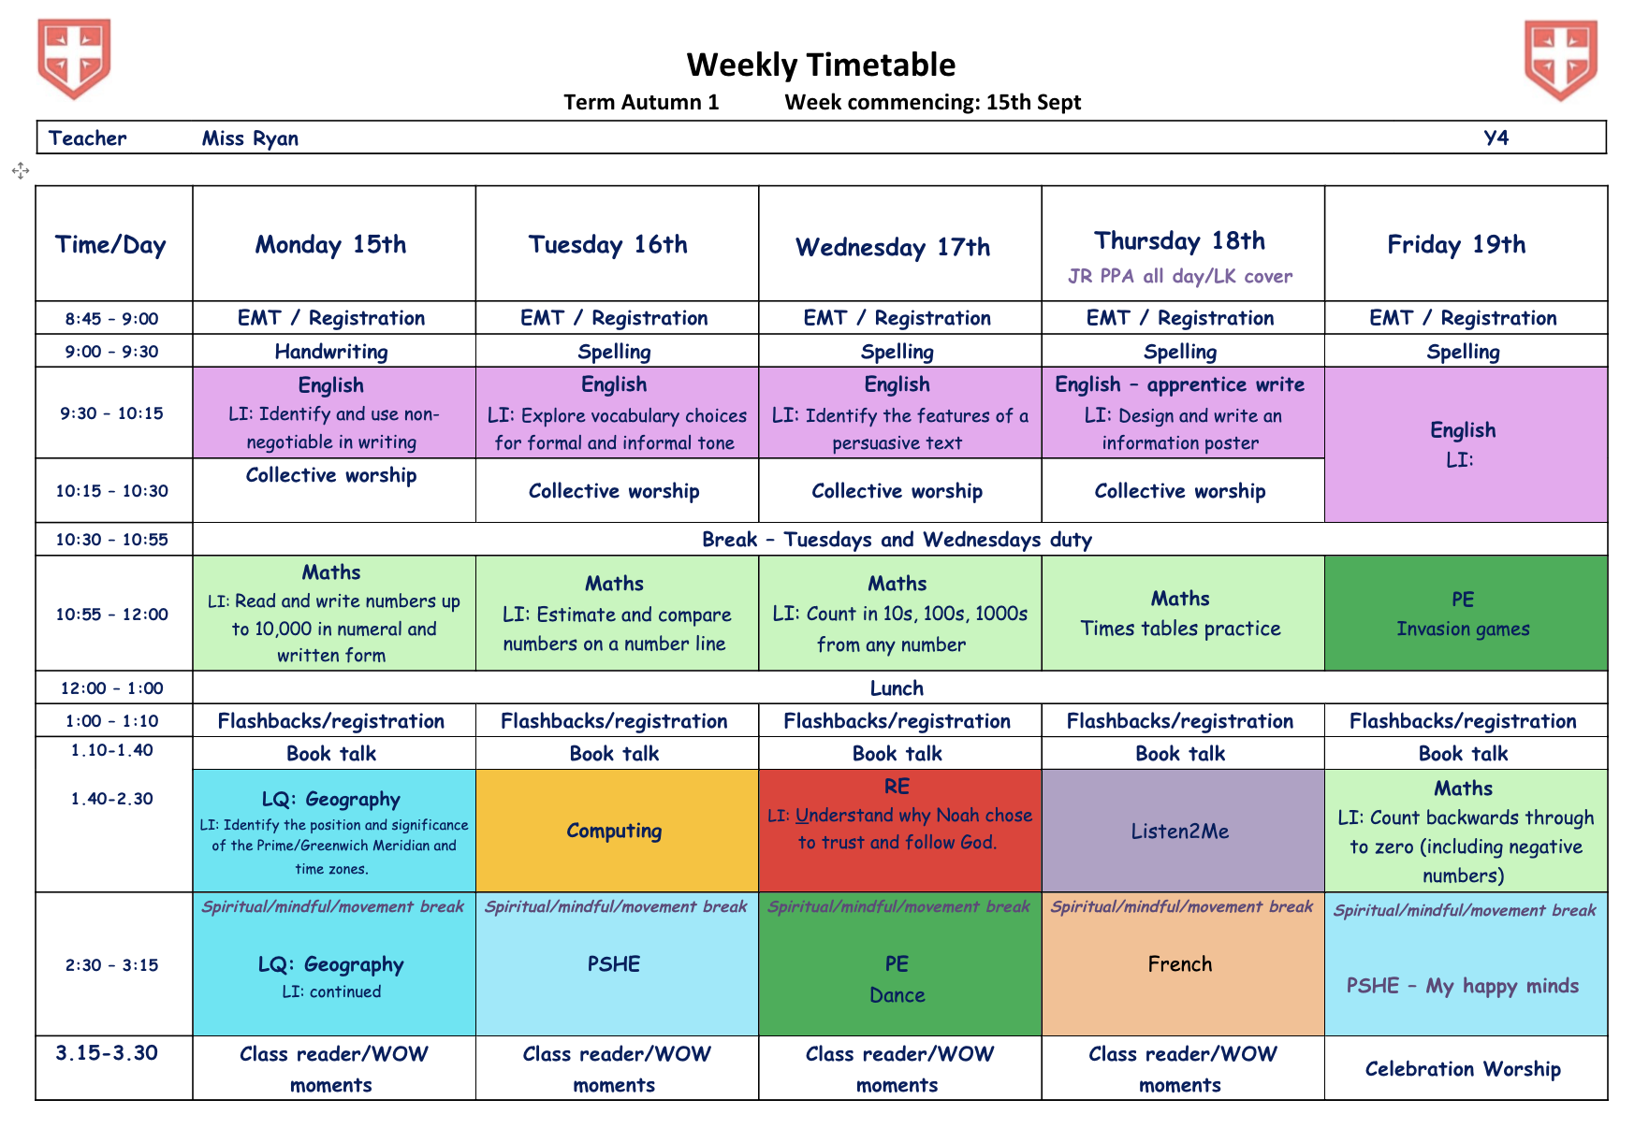
Example Timetable
Notes:
This is an example of our timetable and things will change as we go through the year and as the class evolves.
This is roughly wat to expect.

Slide 7
Roles and Responsibilities
To be in school every day and on time.
To be in full and correct school uniform.
Ensure all letters are read.
All snacks are to be labelled clearly and in the class.
High expectations of presentation of all work.
Self-regulation.
Excellent behaviour for learning.
Build independence
Build resilience.
Notes:
Attendance is key.
Uniform – See the uniform policy. No jewellery or nail varnish. Hair decorations should be functional, not decorative and in school colours of red, white or blue. Please check the uniform policy for PE kit.
Ensure you read all letters and communications sent from school. Please ensure you complete any permission slips.
Presentation – Homelearning to completed in blue pen for English, pencil for maths. All the children were given their stationery packs from last year.
Snacks – Out of lunchboxes and in the snack basket.
Self Regulation – XXX needed - Toilet – Unless there is a specific medical condition, children will need to go before school, break and lunch times and then after 2pm in the afternoon. Please let the team know if anything arises that may affect this (preparation for secondary school)
Behaviour – not last because it’s the least important, but because it is vital for children to maximise their learning time in school (behaviour for learning, taking responsibility for themselves, their actions and their words, tale-telling, talking)

Slide 8
Uniform and belongings
Shoes
No jewellery – except standard watches
Earrings - must be simple gold, silver or clear gemstones
PE kits – No earrings to be worn on these days
Book bags – one small keyring
Coats and jumpers – clearly labelled
Water bottles – clearly labelled and cleaned every evening
Snack pots – clearly labelled and cleaned every evening
Uniform Policy
Notes:
Labelling - Please label all uniform with your child’s name!
Shoes - Shoes of a traditional school type in plain black, navy blue or red. Trainers for PE
Jewellery - No Jewellery. Earrings must be simple studs. Must be removed for PE by the child and put back in. Watches are fine but only if they are not a distraction. NO ALARMS. Activity trackers and smart watches are not allowed – cost, distraction, ability to text/access the internet.
PE Kit - PE kit must be correct and labelled. Children must have a change of white socks for PE. Trainers must be plain black, white or blue – not visible logos – use a Sharpie.
Book Bags – 1 small key chain. If there are more, your child will be asked to remove and keep them at home. If they continue to come into school, they will be removed by staff and left in the office to be collected by you.
Coats - Coats need to be warm and waterproof (no hoddies or jumpers). Please keep and eye on the weather. Please ensure hats, scarves and gloves are named and encourage your child to look after these items.

Slide 9
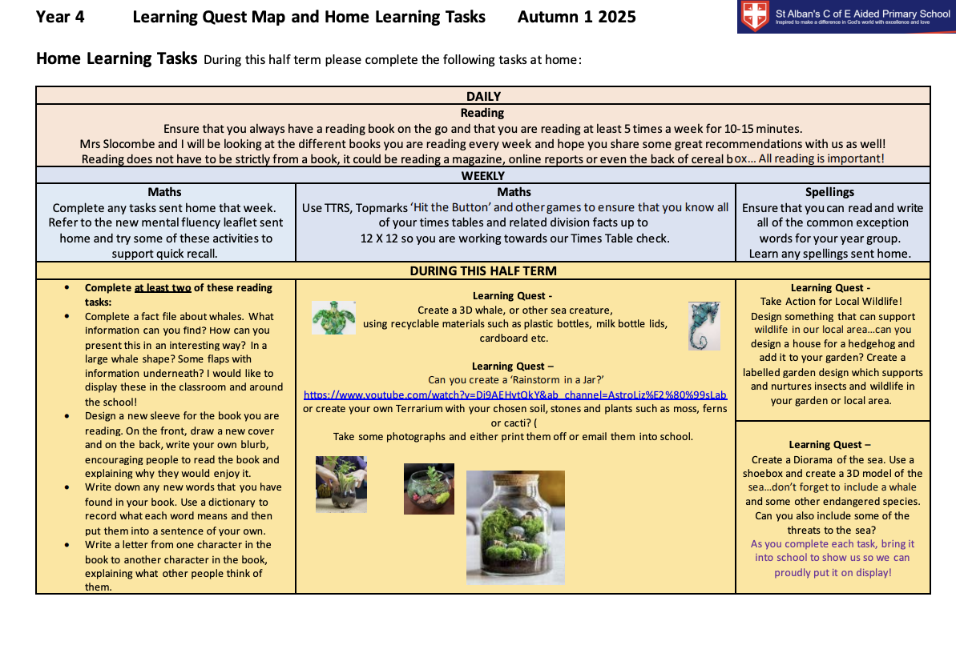
Home learning
Daily Reading
Daily TT Rock Stars – 5 times a week (times table check)
Spellings
Notes:
Daily Reading – 20 minutes, signed by an adult. Rocket Reads. See inside of Reading Diaries for more information.
Daily TT Rock Stars – 5 times a week - More information will be available on TT Rockstars later this term.
Half Termly Spelling – More information to follow.
Children have a choice to complete homework at home or in school. But it must be completed.
All CGP Tasks will be posted as assignments on Google Classroom on Fridays.
Answers for the tasks will be posted on Tuesday, before the handing-in the deadline of Wednesday. Children are expected to self-mark honestly AFTER completing their homework.
Paper copies of the answers are always available for children to complete in school.
Children must post their scores in a private comment before handing in their assignments on time.

Slide 10
General information
PE days – Tuesdays and Fridays.
Reading Diaries in on Friday to be checked weekly.
Home Learning can be brought into school or pictures can be emailed.
Library time TBC

Slide 11
Any Questions?

