Slide 1
The Words of Jesus
Hope and Inspiration
Notes:
Week 1 – What Is Peace?

Slide 2
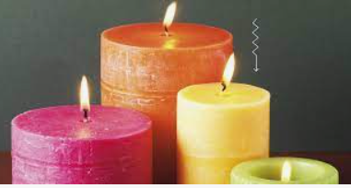

Lord Jesus,
We light this candle to remind us that You are the Light of the World.
As we come together to pray and praise, may your light remove all darkness from our lives.
Amen.

Slide 3
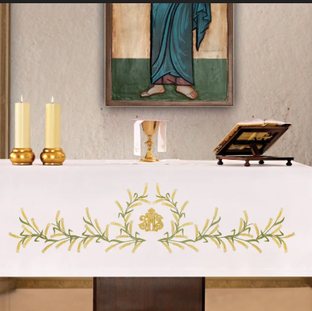
Gold and White
What do the colours mean?
Joy and purity
When else do we see white/gold?

Slide 4
Epiphany
The revealing of Jesus to the world.
6th January
Notes:
What is Epiphany?

Slide 5
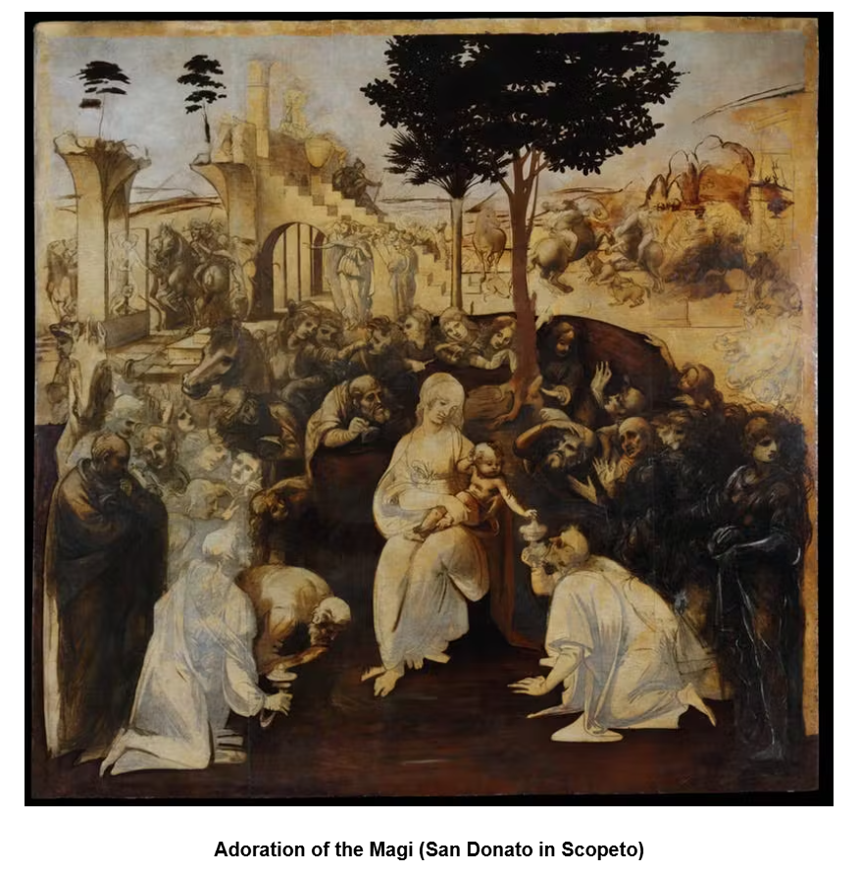
Leonardo da Vinci
1482 c.
Notes:
Epiphany means “appearance or manifestation.” Throughout the world, Christians celebrate it on January 6 - 12 days after Christmas Day. Many countries refer to it as “Three Kings Day.”
The painting, which Leonardo undertook to finish within 30 months, had the Adoration of the Magi as its subject, i.e., the celebration of the feast of the Epiphany when, according to St Augustine, all people respond to the call of Christ. For this subject, Leonardo studied an extremely complex composition, rich with figures, set out in a semi-circle, with the Virgin and Child as the focus. In the foreground, the kneeling Magi offer their gifts of gold, frankincense and myrrh to Jesus.

Slide 6
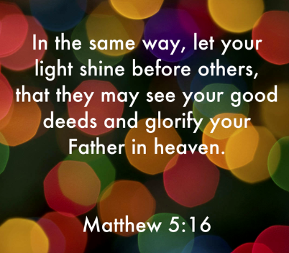
“Let your light shine before others…”
Matthew 5:16
Notes:
Jesus taught about letting your light shine in Matthew 5:16, which states, "Let your light so shine before men, that they may see your good works, and glorify your Father which is in heaven."
This verse emphasizes the importance of living a life that reflects God's goodness and love, encouraging believers to show their faith through actions that are visible to others.
It is part of the Sermon on the Mount, where Jesus teaches about the values of the Kingdom of God and the role of believers as salt and light in the world.

Slide 7

Notes:
Symbolic action: switch off lights → light candles/torch → show how one small light affects the whole space.
Discuss examples of school “light shining”: pupils helping others, excellent work, serving the community.

Slide 8
…the loving actions of staff and pupils, who are empowered to make a difference
Strong relationships are at the heart of school life, nurturing a happy environment where people are known and valued. As a result, care and kindness permeate the school, enhancing wellbeing.
…kindness and togetherness infuse the school, enriching the lives of pupils and families.
Notes:
Pupil Leadership:
HT share quotes from SIAMS report – Dec 25 examples of others “shining” in school.
Explore the words of Jesus: how every child can shine through kindness, learning, creativity, and courage.

Slide 9
…pupils use key messages to inspire their actions. For example, small acts of kindness, rooted in the school’s values, transcend the school.
…value of love is at the heart of school life, inspiring a culture of living well together.
The words of Jesus: every child can shine through kindness, learning, creativity, and courage.

Slide 10
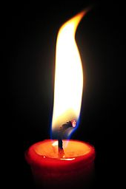
Prayer
Jesus,
Help us shine with love, kindness, and excellence so others may see Your light through us.
Amen

Slide 11
The Words of Jesus
Hope
and Inspiration
Everyone can shine through kindness, learning, creativity, and courage.

Slide 12
LEADER
Send us out in the power of your Spirit
to live and work to your praise and glory.
ALL
May the grace of our Lord Jesus Christ, and the love of God, and the fellowship of the Holy Spirit be with us all, now and evermore. Amen

