Slide 1
The Words of Jesus
Respect and Compassion
Notes:
Week 2 — “Do to Others as You Would Have Them Do to You”
Scripture: Luke 6:31
Value: Respect & Compassion
Vision Link: Love lived out through everyday choices.
Worship Outline:
Reflection/Prayer:
“Loving God, teach us to treat others with the same love and respect we hope to receive.”
Pupil Leadership:
Children lead a short role-play of respectful choices.

Slide 2
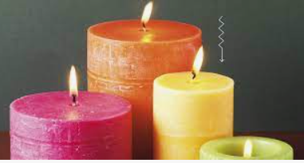

Lord Jesus,
We light this candle to remind us that You are the Light of the World.
As we come together to pray and praise, may your light remove all darkness from our lives.
Amen.

Slide 3

Respect and Compassion
Notes:
Discuss – what does this mean?
Respect and Compassion
Compassion goes a step further. While empathy allows you to feel someone’s pain, compassion includes the desire to help ease their suffering. It includes empathy—but adds action, warmth, and intention.

Slide 4

‘Do unto others as you would have them do unto you.’
Matthew 7:12
Luke 6:31
Notes:
The Golden Rule, as taught by Jesus, is encapsulated in the phrase "Do unto others as you would have them do unto you." This principle is found in the Bible, specifically in Matthew 7:12 and Luke 6:31. It serves as a fundamental ethical guideline, emphasizing the importance of treating others with the same respect and kindness that one desires for oneself. This teaching is central to Jesus's ethical instructions and reflects the broader biblical call to love one’s neighbor
Door moments are one way to explore our own spirituality and how this relates to our relationships with others. This reflection focuses on serving others as an outworking of our spirituality, understanding our place in creation as part of a community.

Slide 5
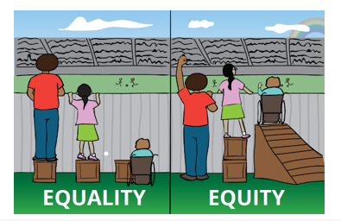
Inclusion
Notes:
Use simple scenarios: sharing, playground behaviour, inclusion.#
Link to school behaviour expectations and what respect looks like.

Slide 6
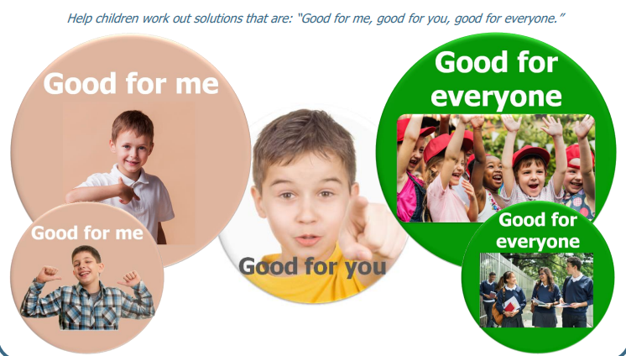
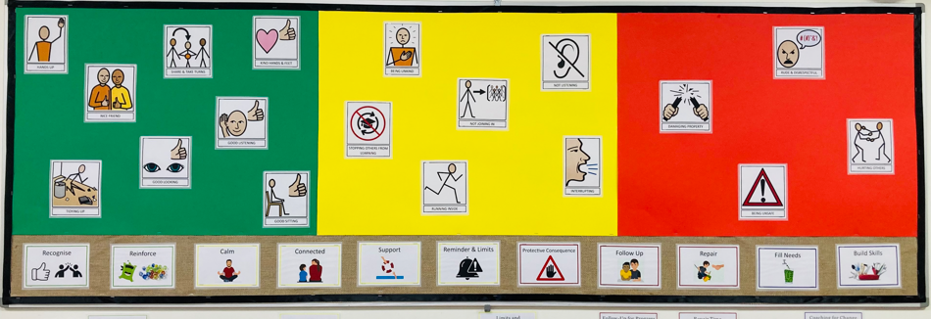
Relational Policy

Slide 7
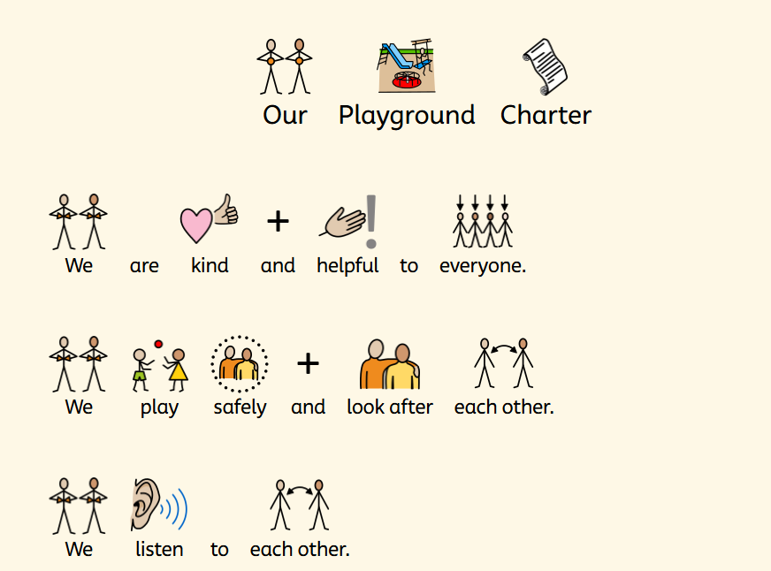

Slide 8
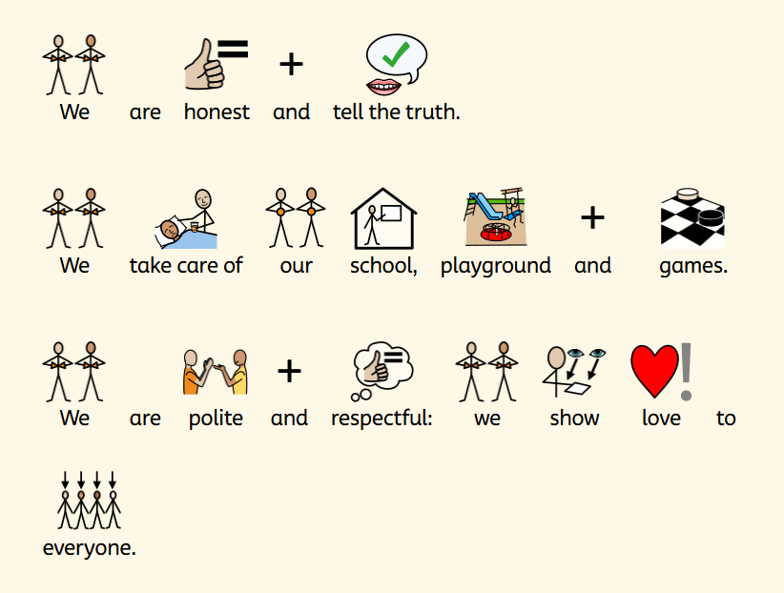

Slide 9
…the loving actions of staff and pupils, who are empowered to make a difference
Strong relationships are at the heart of school life, nurturing a happy environment where people are known and valued. As a result, care and kindness permeate the school, enhancing wellbeing.
…kindness and togetherness infuse the school, enriching the lives of pupils and families.
Notes:
Pupil Leadership:
HT share quotes from SIAMS report – Dec 25 examples of others “shining” in school.
Explore the words of Jesus: how every child can shine through kindness, learning, creativity, and courage.

Slide 10
…pupils use key messages to inspire their actions. For example, small acts of kindness, rooted in the school’s values, transcend the school.
…value of love is at the heart of school life, inspiring a culture of living well together.
The words of Jesus: every child can shine through kindness, learning, creativity, and courage.

Slide 11
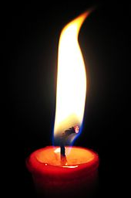
Prayer
Loving God,
Teach us to treat others with the same love and respect we hope to receive.
Amen

Slide 12
The Words of Jesus
This week: Respect and Compassion
What are you going to do to help others?
How are you going to show love whilst doing this?

Slide 13
LEADER
Send us out in the power of your Spirit
to live and work to your praise and glory.
ALL
May the grace of our Lord Jesus Christ, and the love of God, and the fellowship of the Holy Spirit be with us all, now and evermore. Amen

