Slide 1
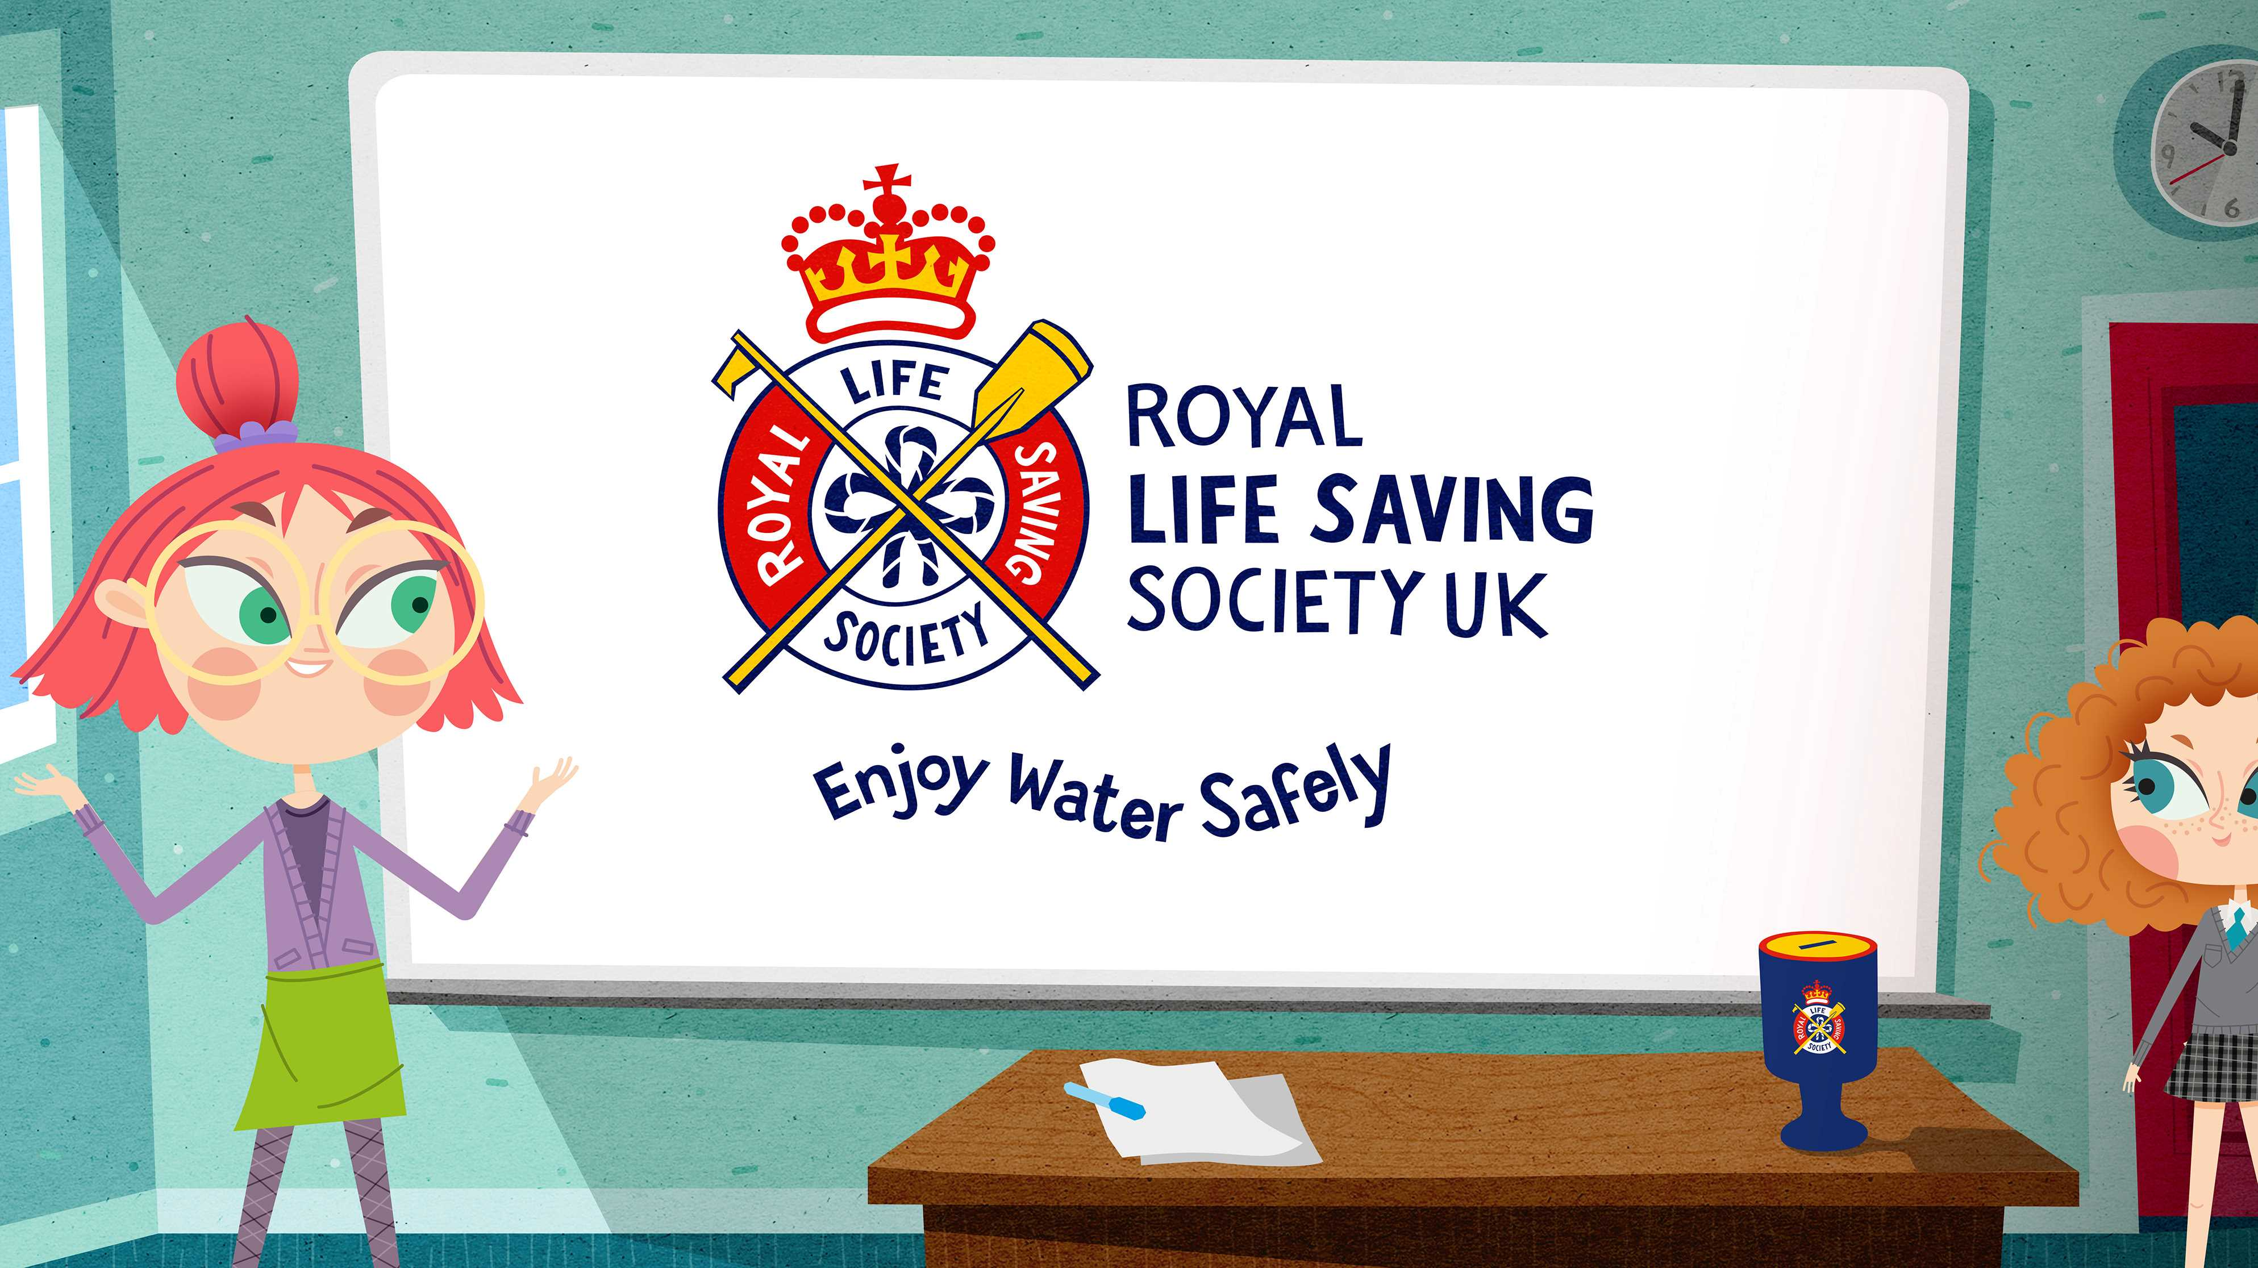
Notes:
Tell the children that we are going to learn about staying safe in and around water. Ask if anyone has heard of the Royal Life Saving Society – explain that it is a charity which educates people on how to enjoy being in, on and around water safely. What might happen if we don’t know how to keep safe around water?

Slide 2
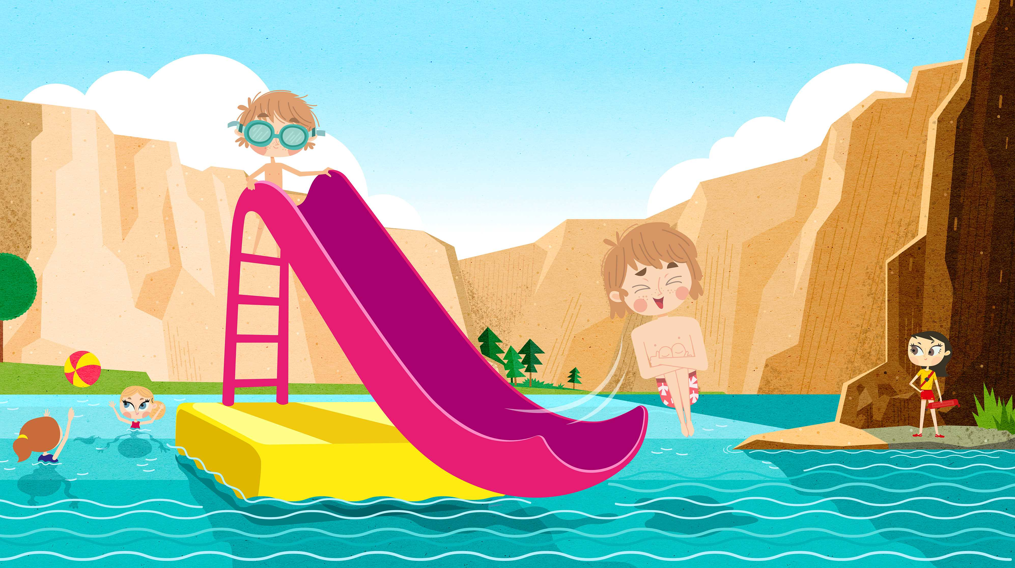
Water is fun!
Royal Life Saving Society UK – www.rlss.org.uk
Notes:
Begin by asking the children about the fun things they can do in, on and around water. If necessary, prompt them by asking who goes swimming, who goes to the beach, who walks near rivers etc.

Slide 3
What different types of water are there?
Swimming pools
Rivers
Hot tubs
Canals
How many did you guess?!
Ponds
The sea
Lakes
Streams
Baths
Reservoirs
Royal Life Saving Society UK – www.rlss.org.uk
Notes:
Ask the question. To avoid answers such as ‘bottled’ or ‘fizzy’, give an initial prompt such as ‘river’ or ‘canal.’ Allow the children some talk time amongst themselves or with a partner, then take answers and briefly discuss with reference to local bodies of water that the children may already be familiar with.
End with the question: is it always safe to play on these types of water? Take a snap survey: who thinks yes, who thinks no? Are some places safer than others? Why might that be?

Slide 4
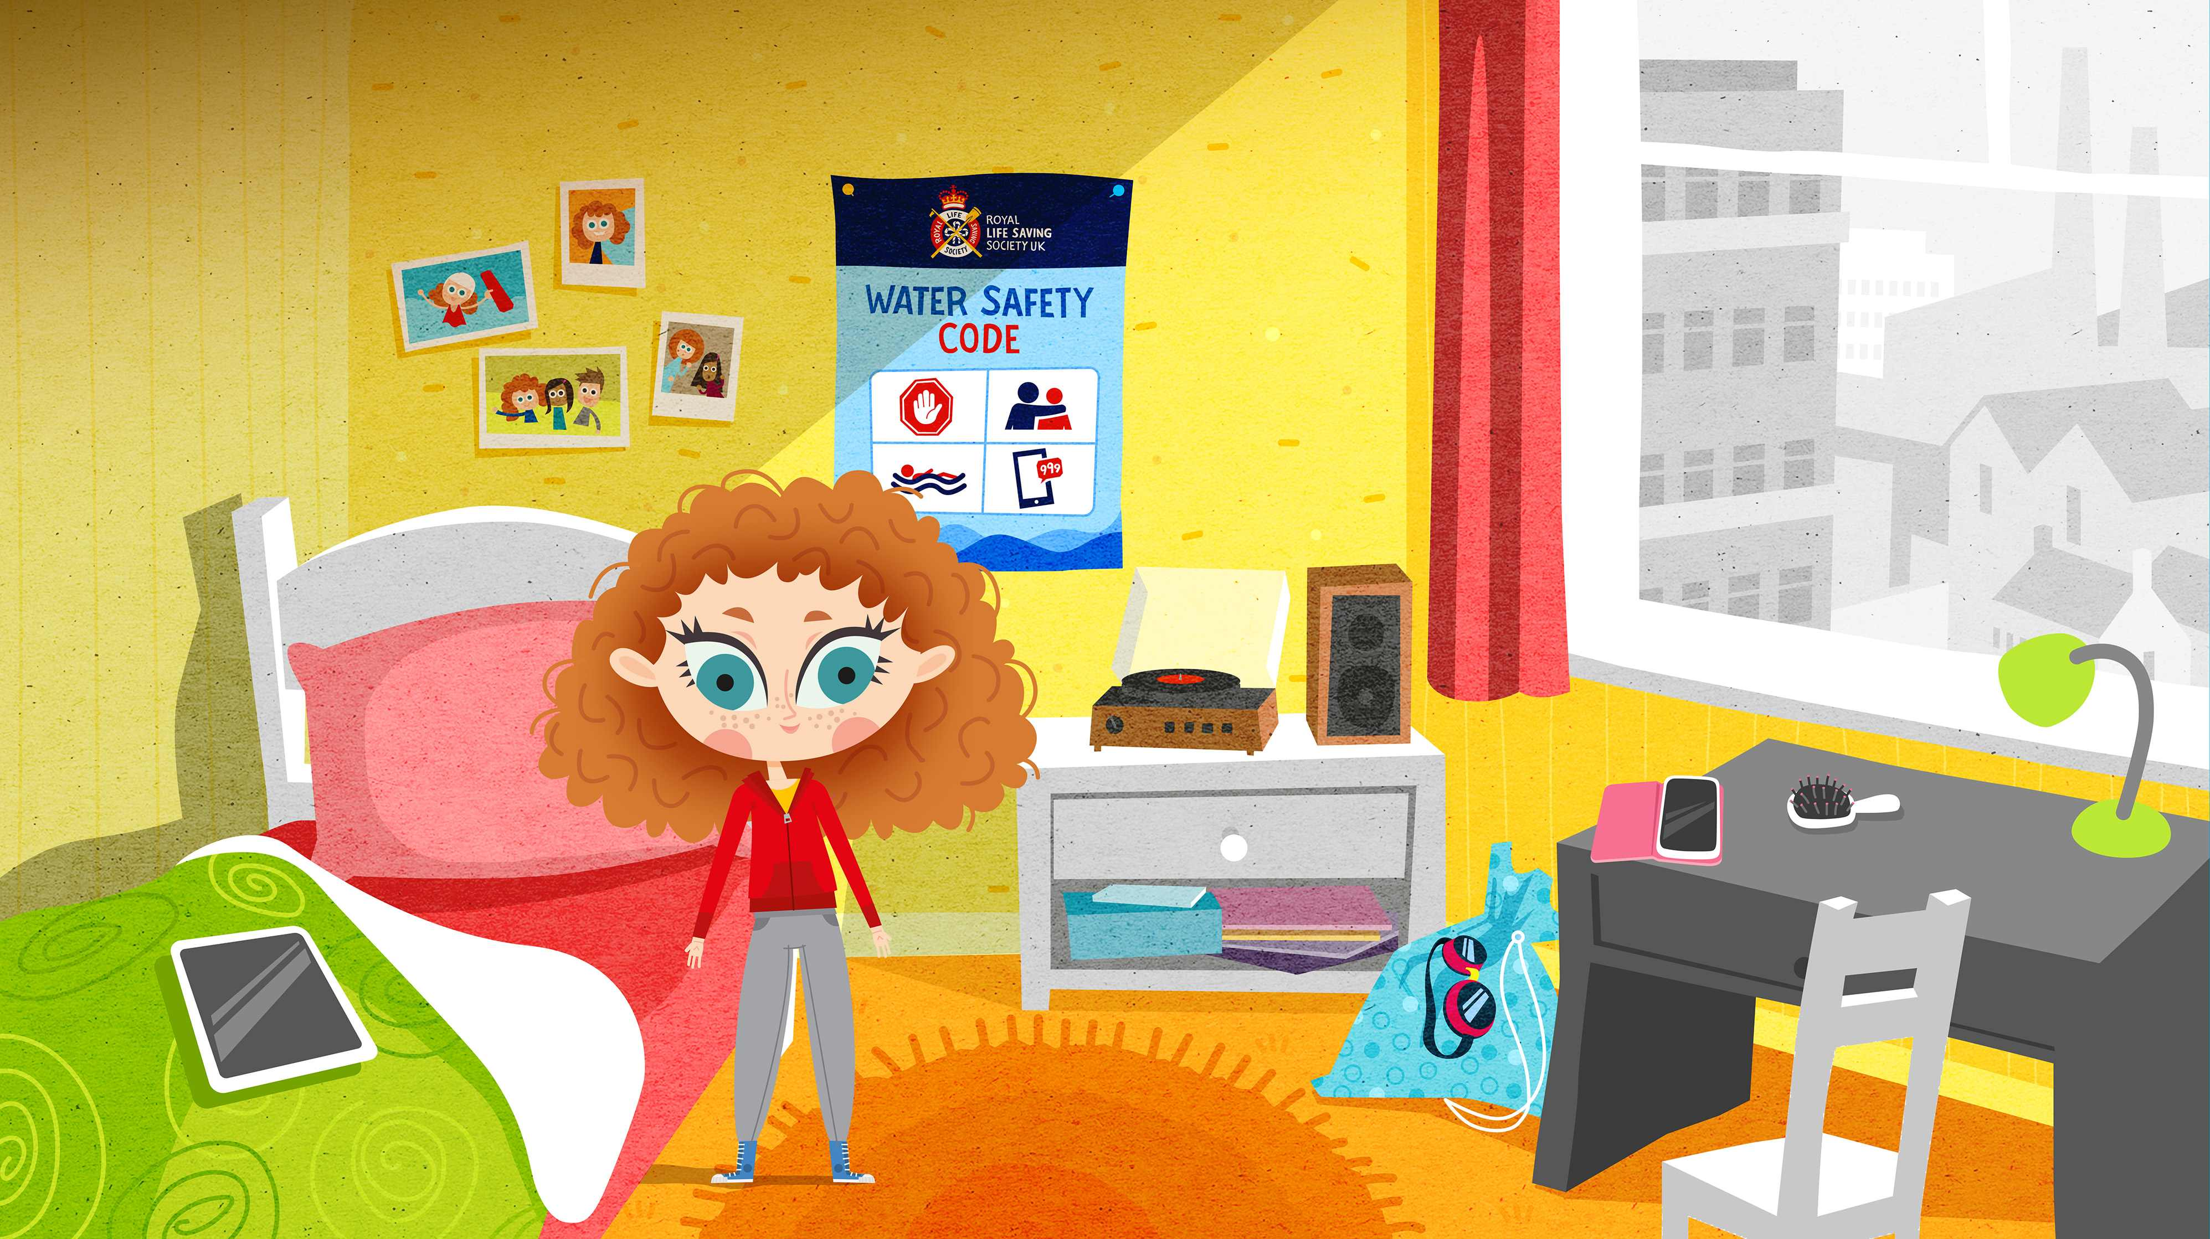
So, what can we do to stay SAFE in, on and around water?
Royal Life Saving Society UK – www.rlss.org.uk
Notes:
Read out the above question, then suggest the children think about the coast (seaside) first. What might we do? What might we see? Allow some talk time. Some children may already know about lifeguards, beach flags and safety equipment. Are we likely to need / see the same sort of things around different types of water, such as a river? Try to make this part relevant to your own locality – you may have a canal, river. lake or quarry nearby with which the children are familiar. Rivers and canals will probably have lifebuoys, warning signs, lighting (especially in built-up areas) – even railings and fences.

Slide 5
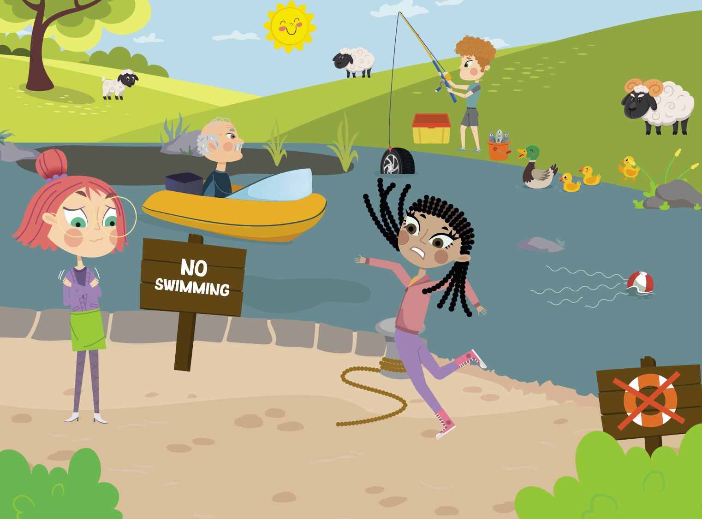
Notes:
After the discussion on keeping safe, ask the students if they can spot any dangers or potential issues in the picture above.
There are at least 9 issues: 1. Trip hazards. 2. Muddy water. 3. Broken rescue equipment. 4. Man on boat doesn’t have a life jacket. 5. Currents can drag you away. 6. Slippery banks. 7. Weeds / branches can trap you in the water. 8. Cold water can affect your ability to swim (cold water shock). 9. hidden rubbish beneath the surface can trap you.

Slide 6
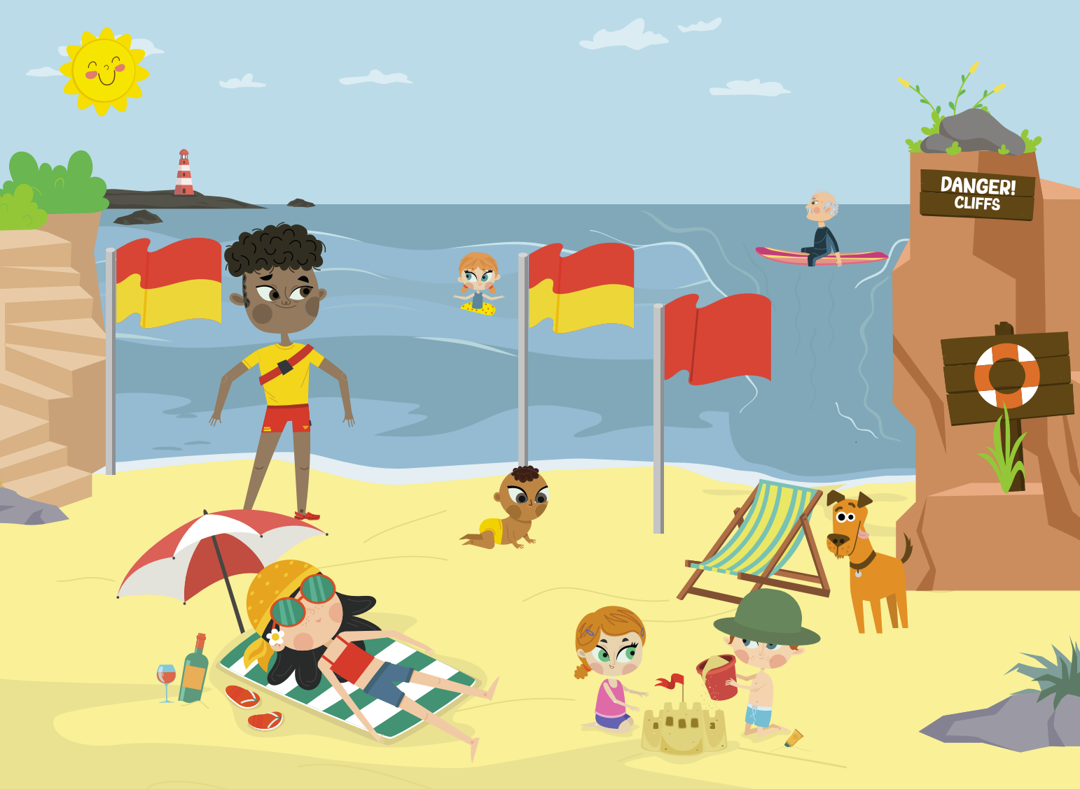
Water safety at the beach
Notes:
After the discussion on keeping safe, ask the students if they can spot any dangers or potential issues in the picture above.
There are 10 points: 1. Cliffs can be dangerous. 2. Strong currents (rip currents) can carry you out to sea. 3. Water can be too deep or too shallow. 4. Red beach flag means danger – no swimming. 5. Red and yellow beach flags mean this is a safe zone and lifeguards are watching. 6. Beaches can be sunny and windy –always wear sunscreen and a hat so you don’t burn. 7. Don’t eat or drink before going in the water. 8. Look for safety equipment. 9 Always listen to lifeguards. Always stay with someone – never go off on your own. 10. never use inflatables in the sea – winds and currents can carry you out into deep water.

Slide 7
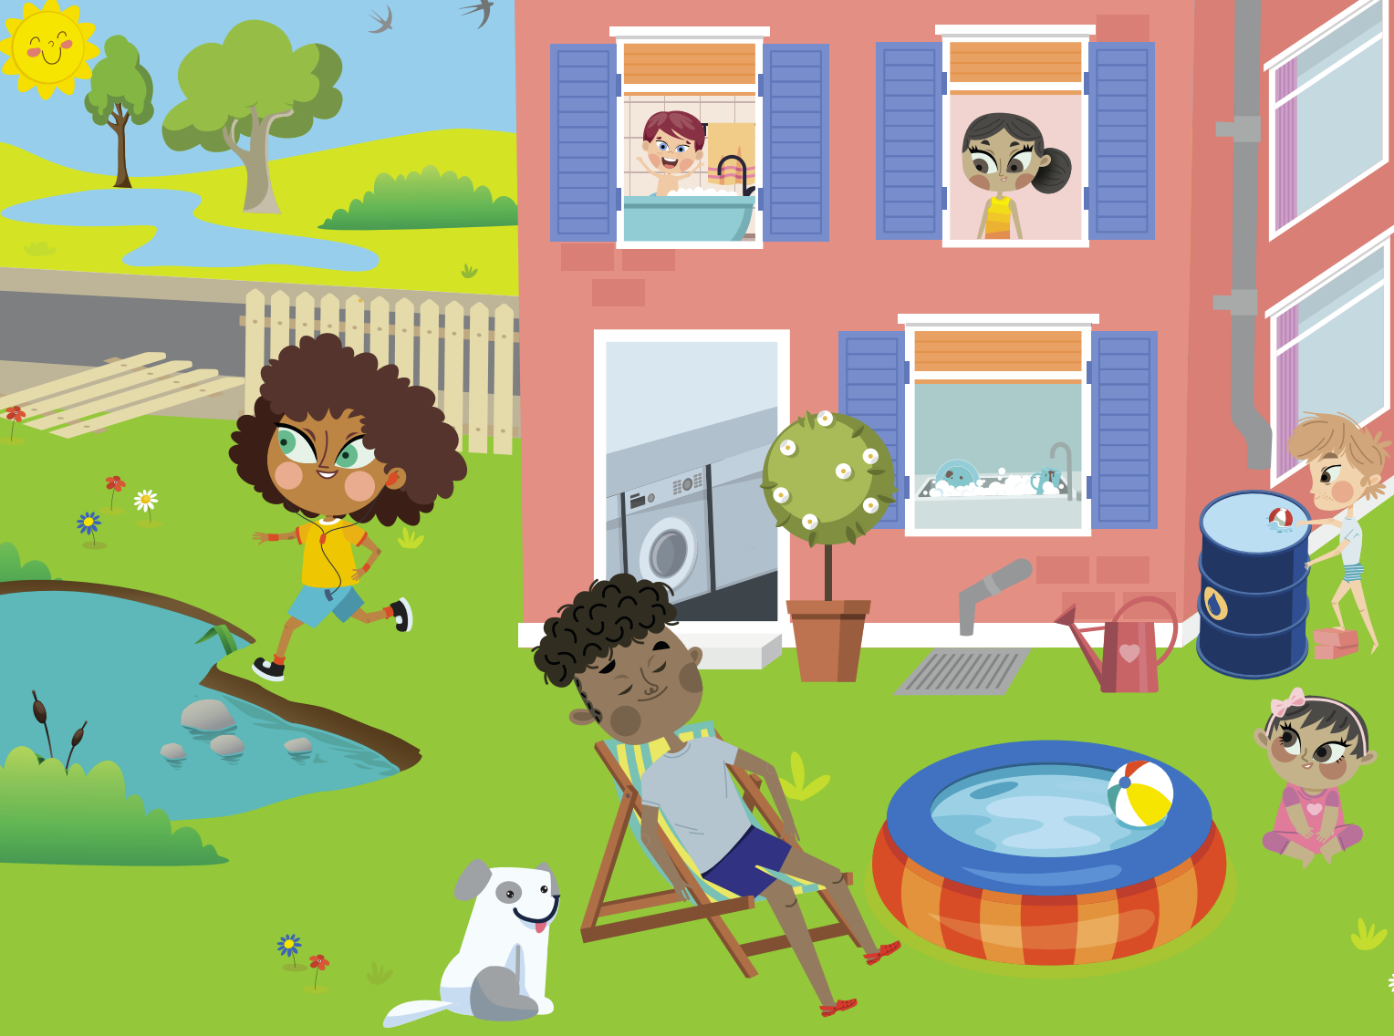
Notes:
After the discussion on keeping safe, ask the students if they can spot any dangers or potential issues in the picture above.
There are at least issues here. 1. Empty paddling pools and buckets after use. 2. Cover all outdoor water containers. 3. Be careful around ponds and lakes around home. 4. Garden gates and fences shouldn’t be broken or open – they keep children from wandering off. 5. Never be around open water by yourself. 6. Washing machines should always be kept shut. 7. Children should never be left on their own in the bath. 8. Make sure sinks and baths are emptied after use – keep the plug away from children so they can’t fill the baths or sinks.

Slide 8
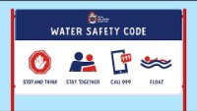
Royal Life Saving Society UK – www.rlss.org.uk
Notes:
Explain that to help keep us safe in and around water, we are going to learn all about the Water Safety Code and that we are going to watch a short cartoon to help us. Click on ‘The Water Safety Code’ title to view the video. At the end of the video, ask if there are any questions. This will also be an opportunity to address any misconceptions.

Slide 9
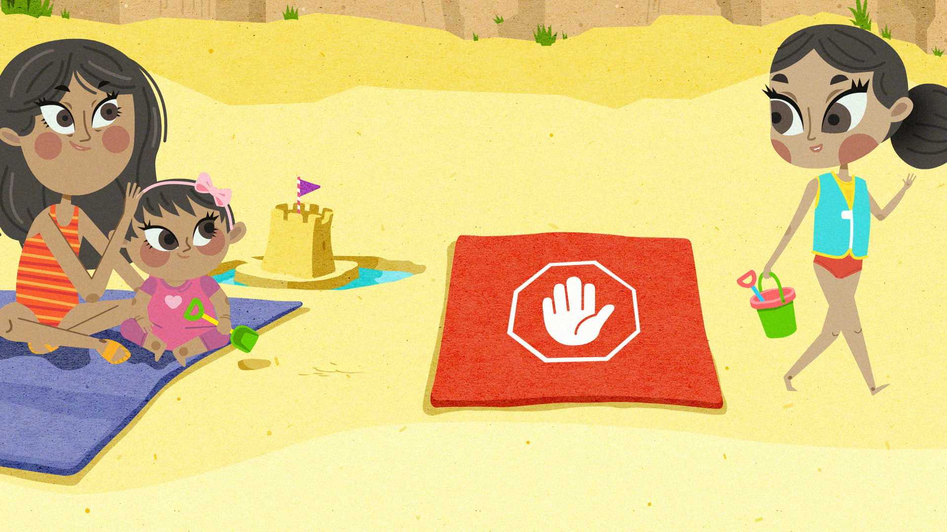
Stop and think
Notes:
This and the next three slides revisit each of the four points of the Water safety Code. You could begin by asking the children to shout out the title, and then ask what the phrase actually means. What sort of things do we need to stop and think about when we are around different bodies of water? You may wish to suggest different types of water at this point i.e. what should we think about at the seaside? The lake? The canal? If you know the area you could make part of the questioning relevant to their locality.

Slide 10
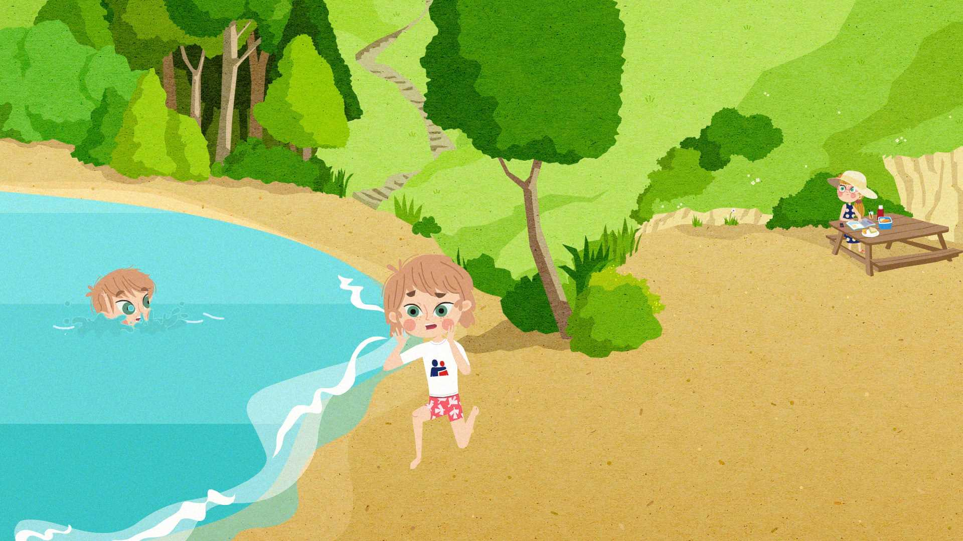

Stay together
Notes:
Emphasise the importance of staying together when around water. It’s more fun with family and friends and if you get in trouble, the people around you can get help.

Slide 11
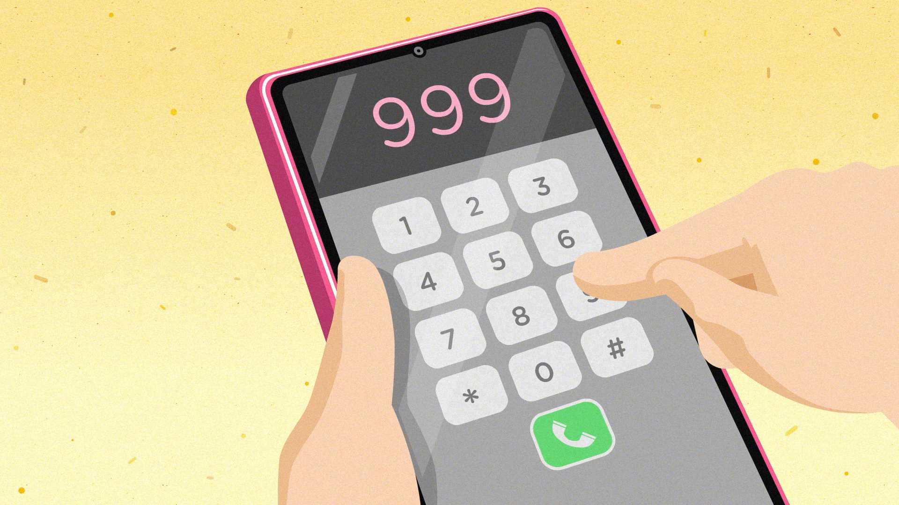

CALL 999
Notes:
If you see someone in difficulty in the water, phone 999 (or 112) or better still, get an adult to do it for you. You may wish to extend this slide by discussing the sorts of things the call handler might ask you i.e. what service do you require? What is happening? Who is involved? Where is it happening? Calling 999 and knowing what to say is dealt with in more detail in one of the water safety lesson plans, but can be mentioned here if the presenter sees fit.

Slide 12
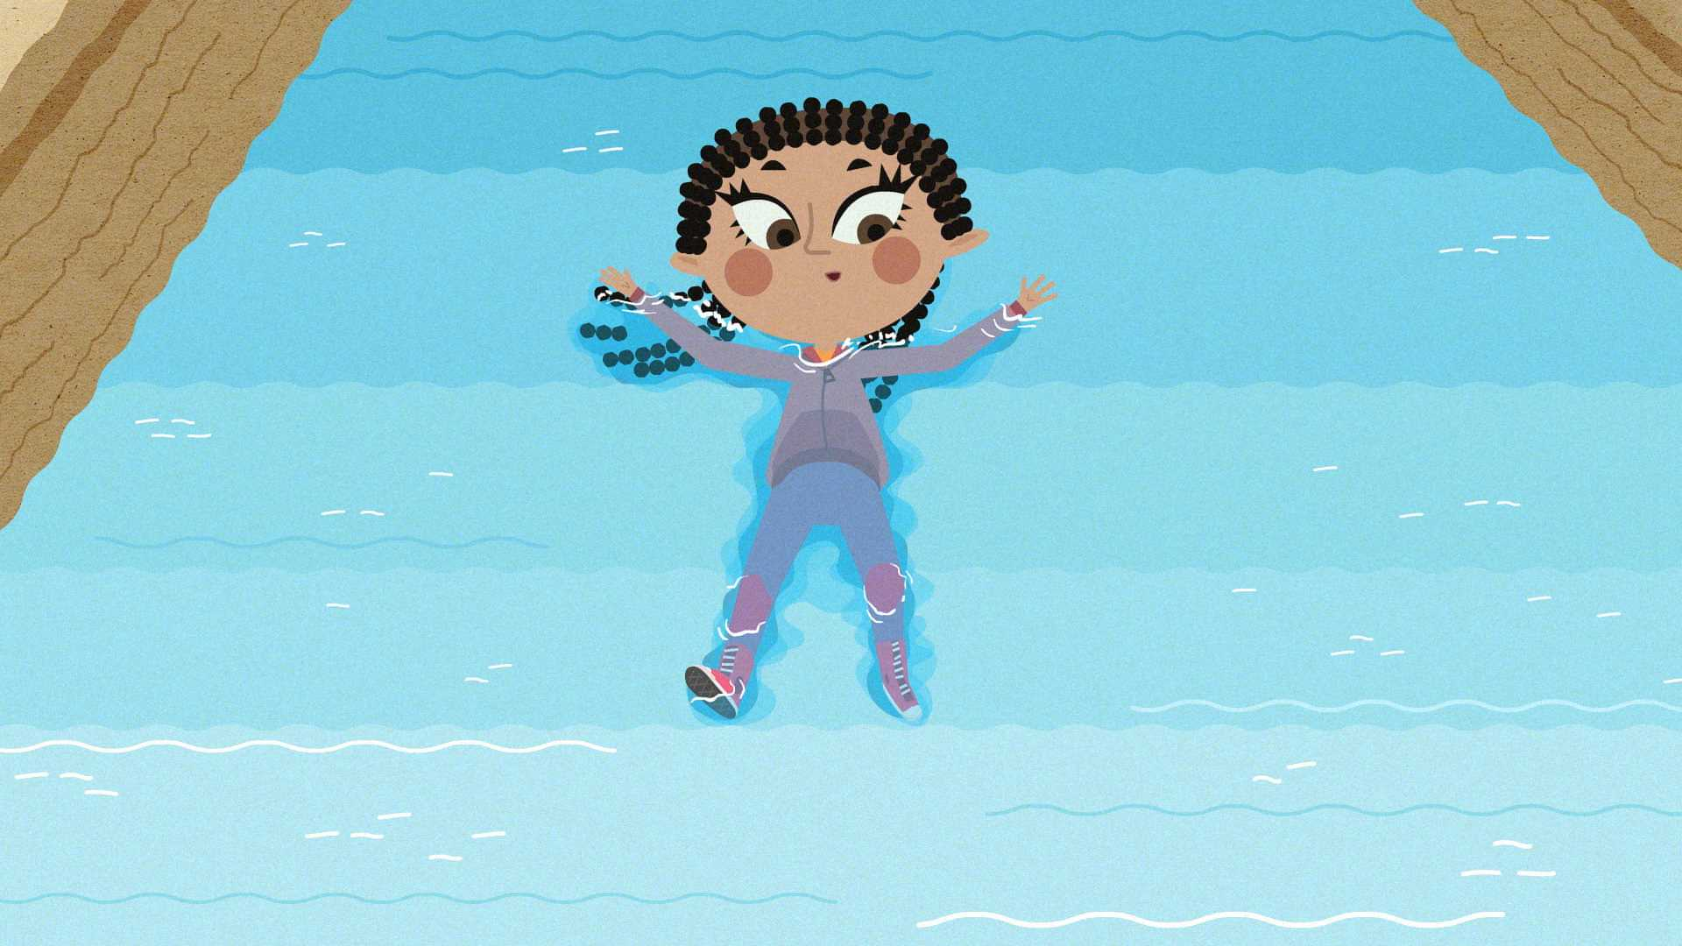

FLOAT
Notes:
If we get into difficulty in water, what do we need to do? (Float on our backs). What shape should we make? (starfish). What should we do next? (Shout for help). Depending on the age of the children, you might want to discuss further what you can do to help i.e. throw in something to help the person float better. Emphasise that we NEVER go into water to help rescue someone or something, as we could end up in difficulty ourselves.

Slide 13
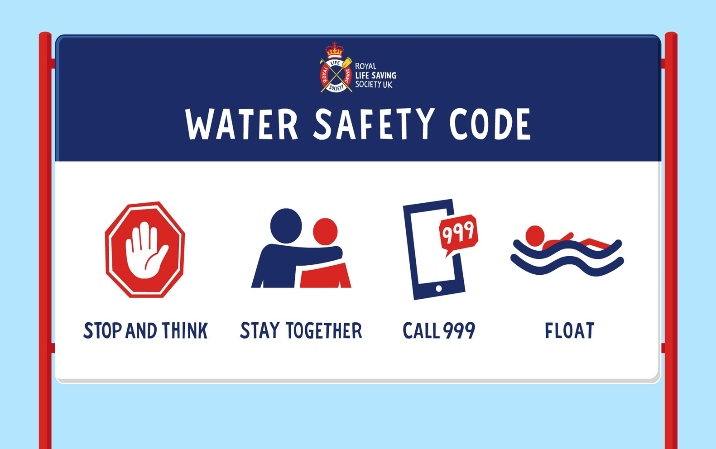




Notes:
The slide will initially appear blank, other than the title. Run this as a test: who can remember what the very first thing we need to remember with the Water safety Code? When you’re given the correct answer – stop and think – click the mouse to display the phrase and ask all children to shout it back to you. Repeat this procedure for the remaining three points of the Code.

Slide 14
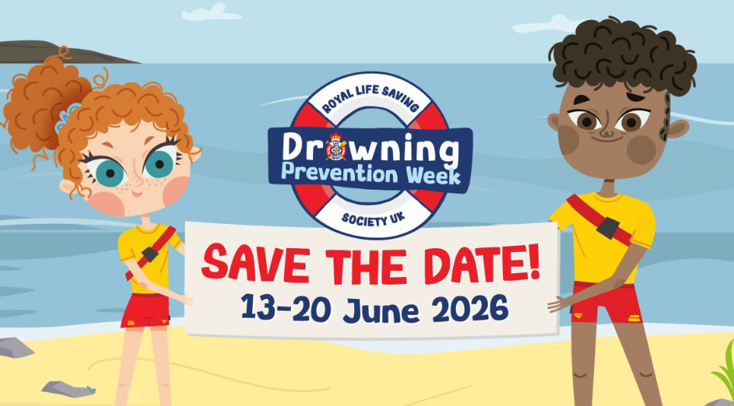

Slide 15
Notes:
Whatever you do and wherever you go, remember the Water Safety Code and enjoy water safely!

