Slide 1

St Alban’s Spelling Workshop
January 2024

Slide 2
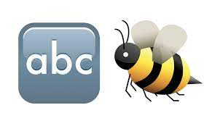

Aims of the workshop
To explore each of the spelling principles that are used to support children in building words.
To understand a range of approaches that are taught in school to support the learning of spelling and how you could help at home.

Slide 3


Starter…
Spell the word __________________.
What strategies do you think you used in order to be able to make a best guess at this spelling?
Discuss.

Slide 4
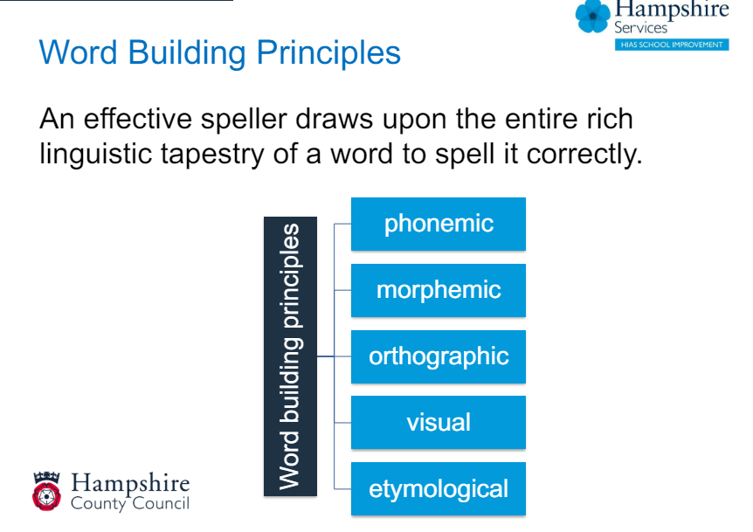
The brain is not wired to spell correctly, each individual brain must learn to spell.

Slide 5
Phonics (phonemic/phonological awareness)
Phonics means the sounds that letters make in words. Children learn these in order to read and spell.
There are 26 letters in the alphabet.
There are 44 sounds.
There are over 140 different ways to combine the 26 letters to make 44 sounds.
We blend sounds together to help us read words (build words up)
We segment words into sounds to help us spell (break words down)

Slide 6
Your turn…
Have a go at segmenting these following nonsense words.
pog tabsug zenlap slitenpog brenpigas

Slide 7
Now try…
chail pightfoy dairang
ch ai l, p igh t f oy, d air a ng
v
v
v
v
v
v
v
v
v

Slide 8

Morphemic - affixes
A morpheme is the smallest unit of meaning
Understanding how words are built improves both spelling and vocabulary.
Morphemic knowledge is concerned with understanding that different parts of the word carries meaning e.g. in ‘birds’, that the ‘s’ marks the plural.
Morphology for very young children improves spelling immediately e.g. writing ‘dogs’ rather then the phonetic spelling ‘dogz’.
Morphemes are quite regular in English - remaining consistent even when the phonology changes e.g. jumped (t), loved (d), hated (id)

Slide 9
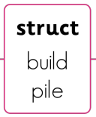
How many words can you make using the root word ‘struct’?
In (up) struct (build) or (one who) - instructor

Slide 10
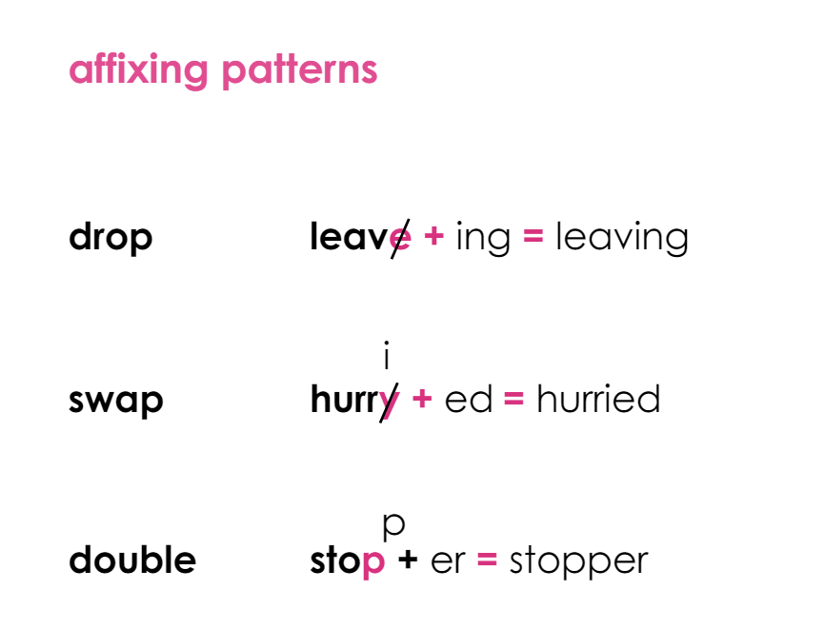

Slide 11
Orthographic
The understanding of which letter sequences are both possible and plausible in English.
They use visual recall to work out where graphemes fit in words correctly.
They recall spellings from words they have previously seen in print – visual memory enables them to read fluently.

Slide 12
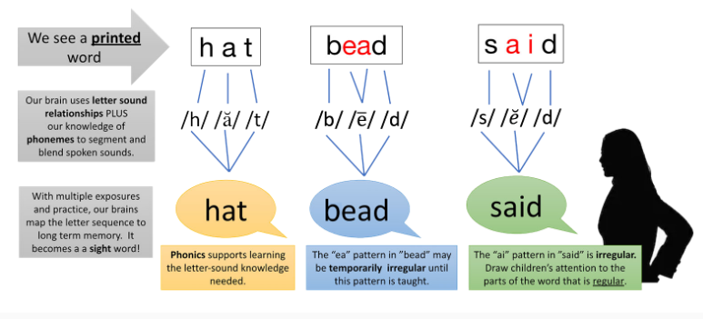

Slide 13
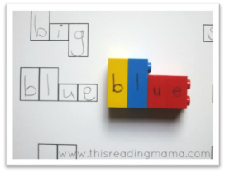
Visual
The look of a word makes an important contribution to knowledge to a successful speller.
A sound visual knowledge makes spellers more fluent and automatic.
Multiple exposures to words in a meaningful context is crucial to ensuring spelling becomes automatic.

Slide 14
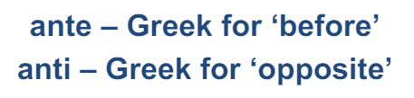
Etymological
Spelling draws from spelling patterns from many different languages.
Relationships between sound and symbol that initially seem obscure are often situated in the origin of the word.

Slide 15
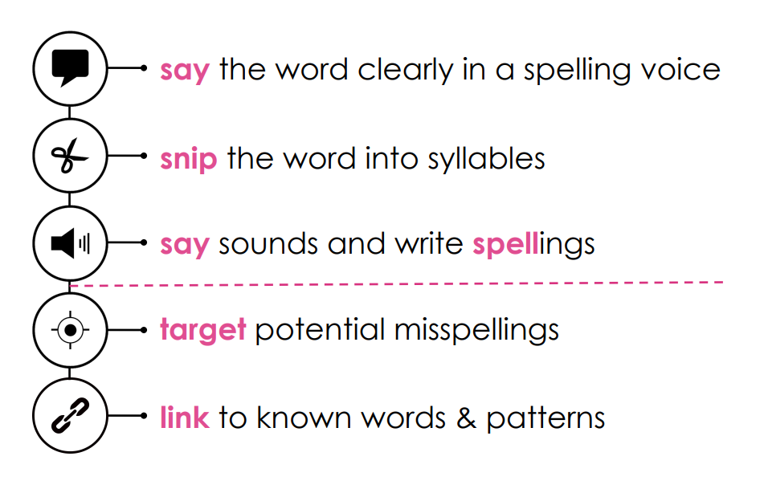
How can you help at home?

Slide 16
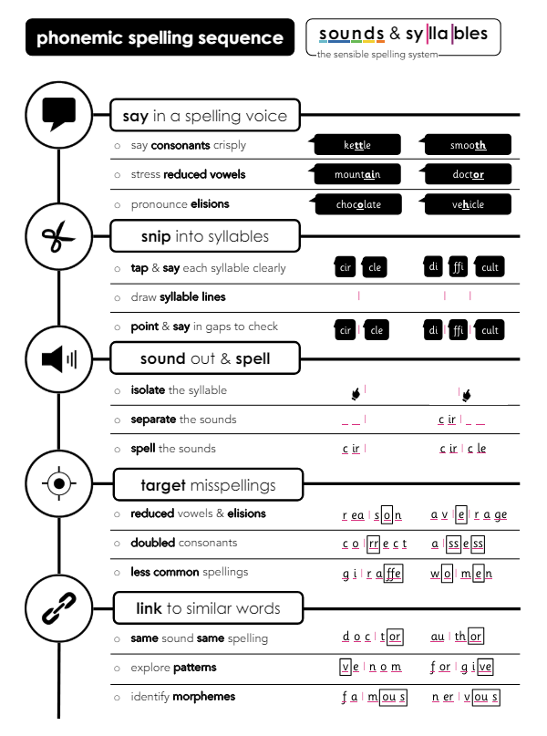

Slide 17
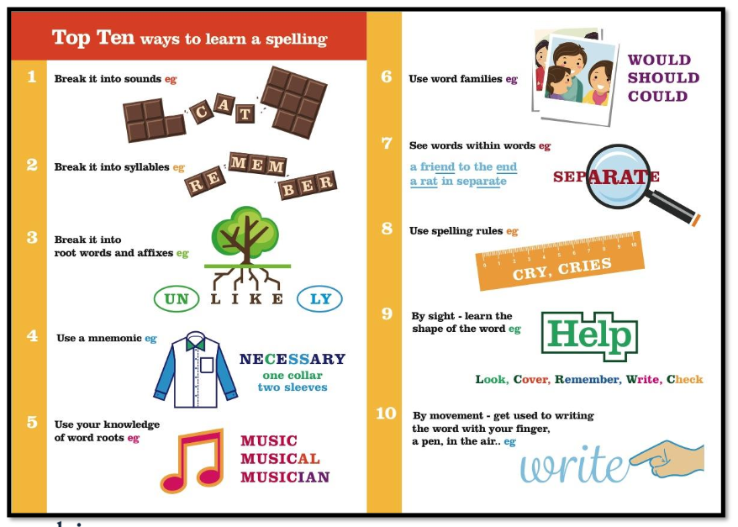

Slide 18
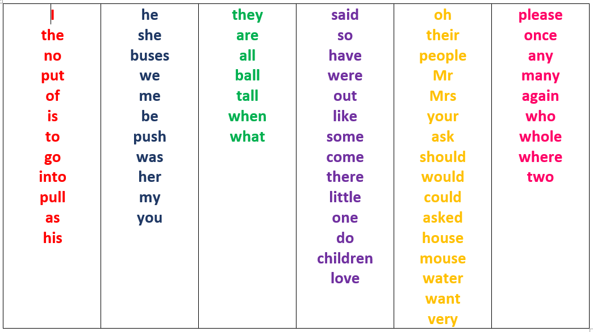
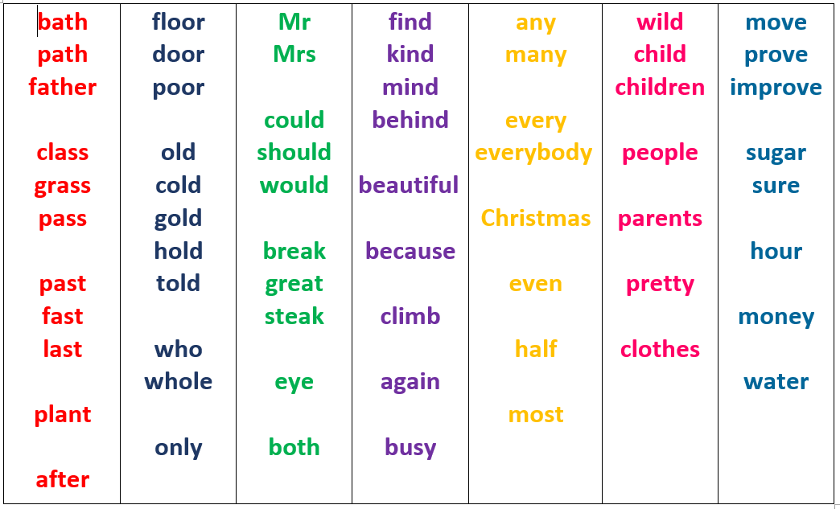
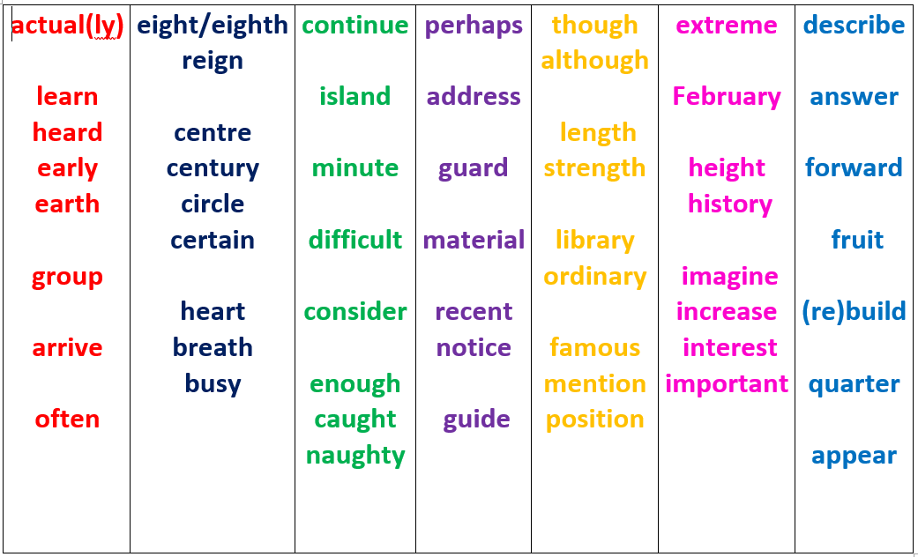
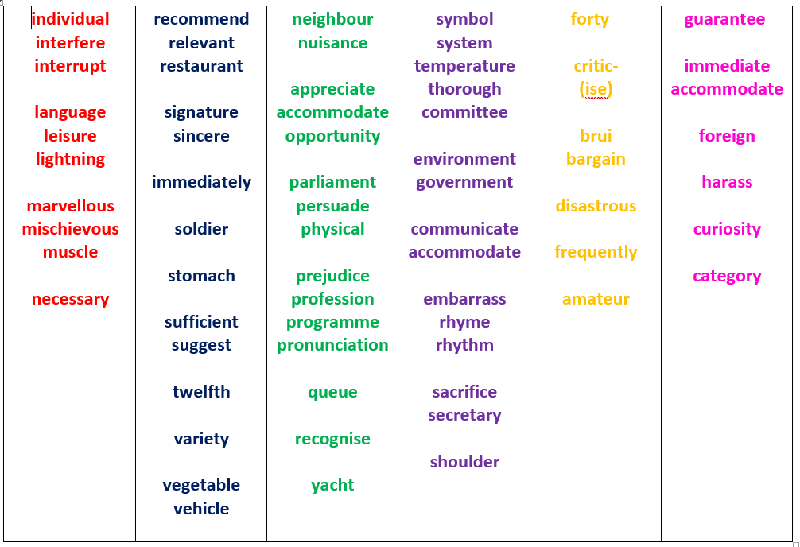
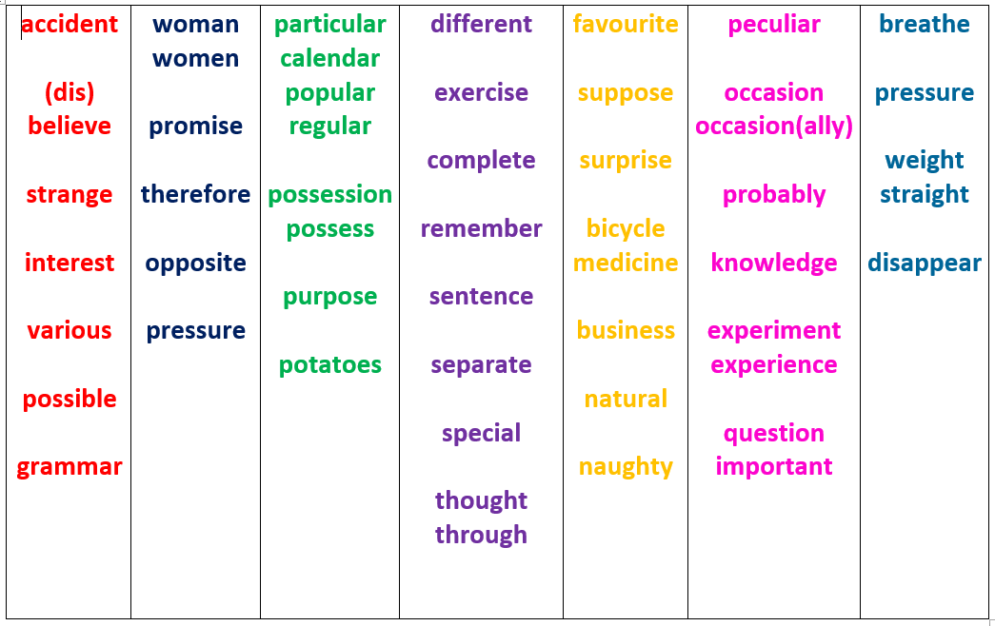
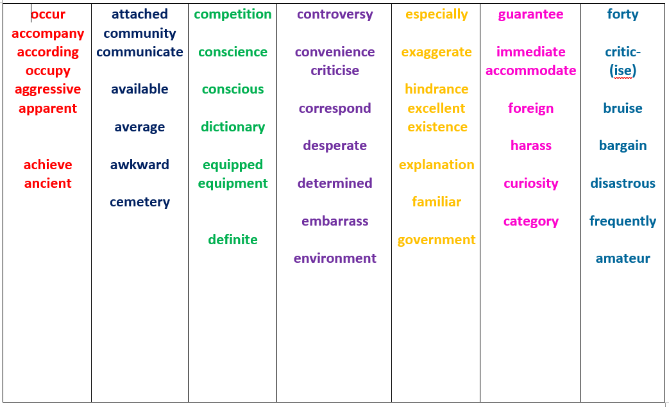

2
3
1
5
4
6

Slide 19

Thank you for coming!
Class visits

