Slide 1
Gathering for worship
Who is my neighbour?

Slide 2
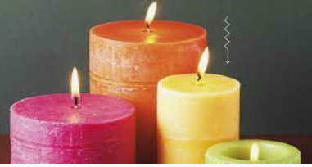

Lord Jesus,
We light this candle to remind us that You are the Light of the World.
As we come together to pray and praise, may your light remove all darkness from our lives.
Amen.

Slide 3
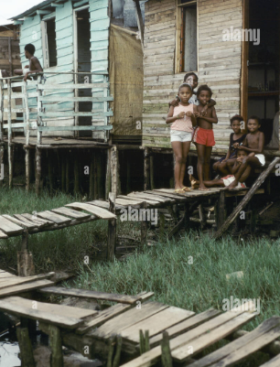
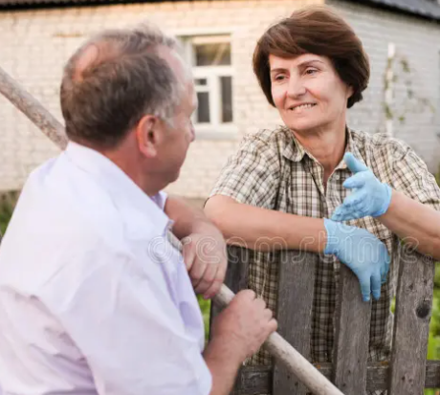
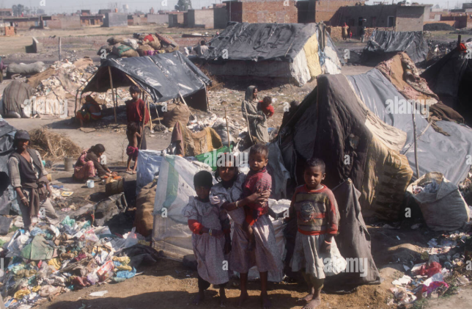
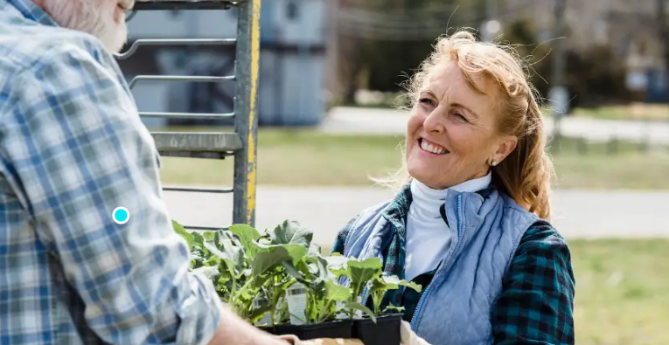
Notes:
Discuss the pictures

Slide 4
Who is my neighbour?
‘The Kind Stranger’
‘The Story of the Good Samaritan’ Luke 10: 25-37

Slide 5
‘Now go and help your neighbour too…’
Discuss who we can help.
What can we do to help them? Discuss.
homeless,
poor,
sick,
refugees
those who have experienced extreme sadness: bullying, loss of a loved one, parents separated
A refugee is someone who has fled from their own country because they don’t feel safe there anymore.

Slide 6

Bubble Prayer
As each bubble moves around, listen to the prayers for those people in need.

Slide 7
Let us reflect on those who need our help.
Dear Lord,
You taught us to look after our neighbours.
Help us to speak in love and compassion
Help us to walk alongside those who are in need.
Help us to be your hands to clothe, feed and give shelter to those in need.
Help us to be your ears to listen to those who need help.
Hear our prayer.

Slide 8

In class…
If a refugee came to our school, how would we make them feel welcome.
Read an extract from:
16-22 June
Refugee Week 2025 - Resources for teaching - BBC Teach

Slide 9
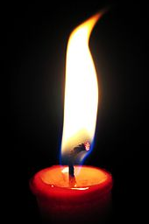
LEADER
Send us out in the power of your Spirit
to live and work to your praise and glory.
ALL
May the grace of our Lord Jesus Christ, and the love of God, and the fellowship of the Holy Spirit be with us all, now and evermore. Amen

Slide 10
Gathering for worship

